Slide 1
Descriptive Analysis of Common Risk Factors Associated with COVID-19 Mortality in Hospitalized Patients in England, 2020.
Presented by : Aneke Chukwunonye

Slide 2
Introduction
This analysis focuses on identifying the most common risk factors associated with COVID-19 mortality, specifically examining the impact of age and comorbidities.
The findings have crucial implications for guiding public health interventions and healthcare resource allocation, particularly during pandemic surges.

Slide 3
Data Overview
Data source: A sample of the ISARIC study data, collected from 208 hospitals in England (during the first wave of the pandemic). Provided to me by my University lecturer for my MSC Course work
Dataset is depersonalised, made up of 50,000 observations and 13 variables. The variables were categorical and of different levels.
Variables of interest: Outcome: (five levels), Age, sex, comorbidities (hypertension, cardiac disease, diabetes, etc.)
Study population: Hospitalized patients admitted with COVID-19 in England between February and June 2020.

Slide 4
Methodology
Study Design: Retrospective descriptive analysis focused on identifying common risk factors.
Analysis was conducted using R software
Data Cleaning and Processing
Reformatting variable types and checking for inconsistent entries
Creating additional variables
Handling missing data
Data Analysis
Descriptive Statistics: Trend of new case identification, Summary of the distribution of outcomes and risk factors (age groups, Sex ,comorbidities).
Mortality rates: Comparison of mortality rate of risk factors.
Visualization: Charts displaying frequency and proportions of key factors in cases.

Slide 5
FINDINGS

Slide 6
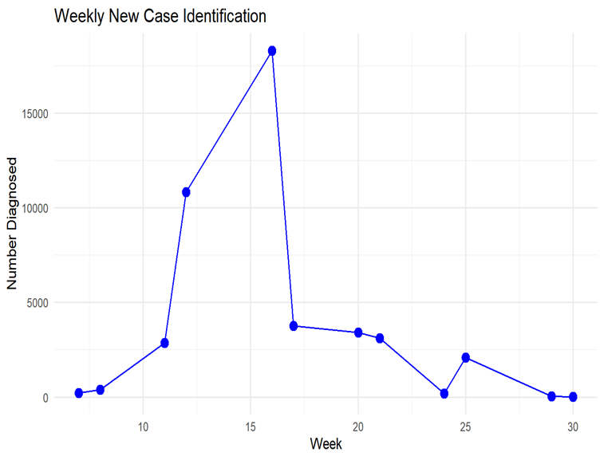
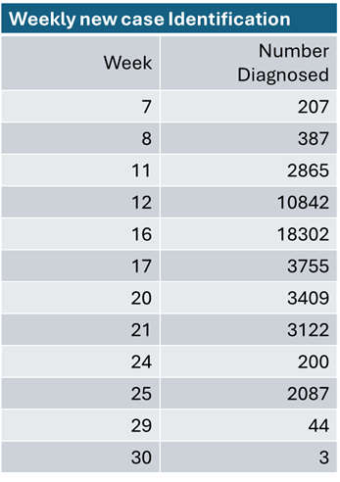
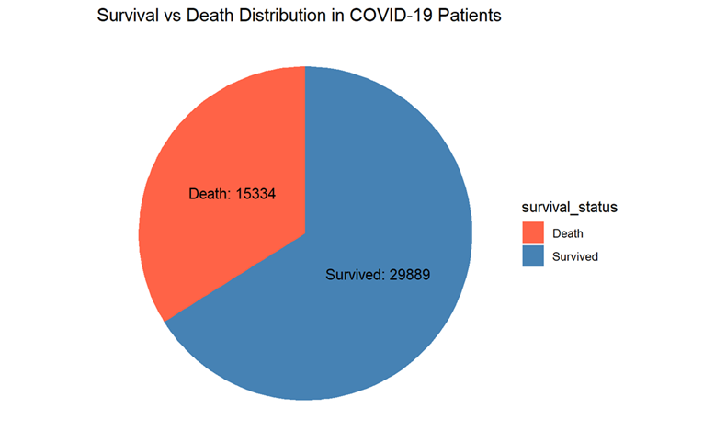
Trend of weekly diagnosis and recorded Deaths
Week 16 saw the peak of new COVID-19 diagnoses with over 18,000 cases.
34% of patients died, while 66% survived (15,334 deaths vs. 29,889 survivors).

Slide 7
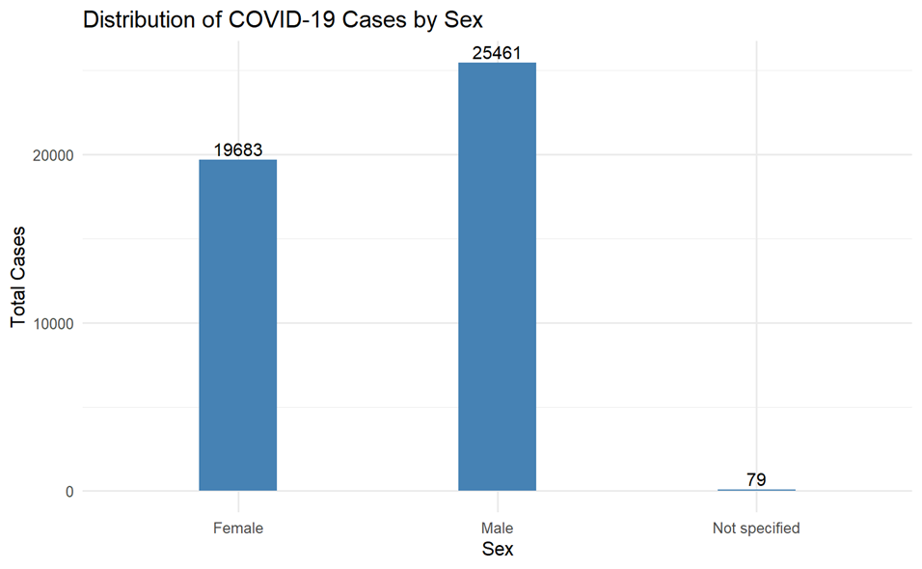
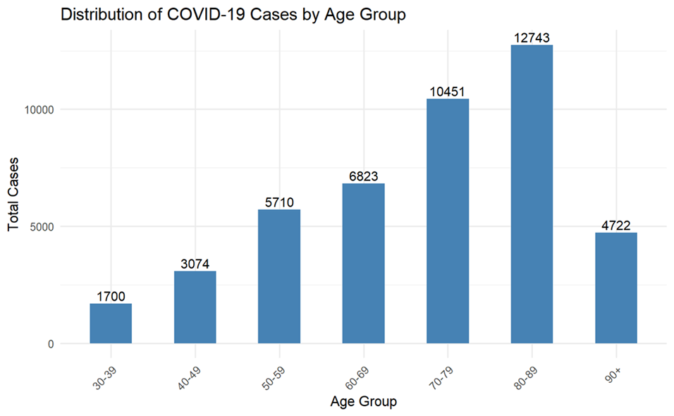
Case distribution by Sex and Age group
Males had more COVID-19 cases (25,461) than females (19,683), indicating a possible sex-based difference in infection or severity.
Elderly groups, especially 80-89 years (12,743 cases) and 70-79 years (10,451 cases), had the highest case counts, showing the increased vulnerability of older adults to COVID-19.
Males were more affected than females (25,461vs19,683), suggesting a potential sex-related difference in susceptibility or severity of infection.
Older age groups, 80-89 (12,743 cases) and 70-79 (10,451 cases), were more represented, highlighting the vulnerability of elderly populations to COVID-19

Slide 8
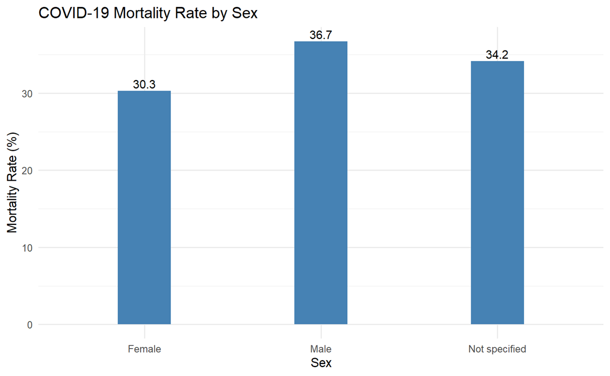
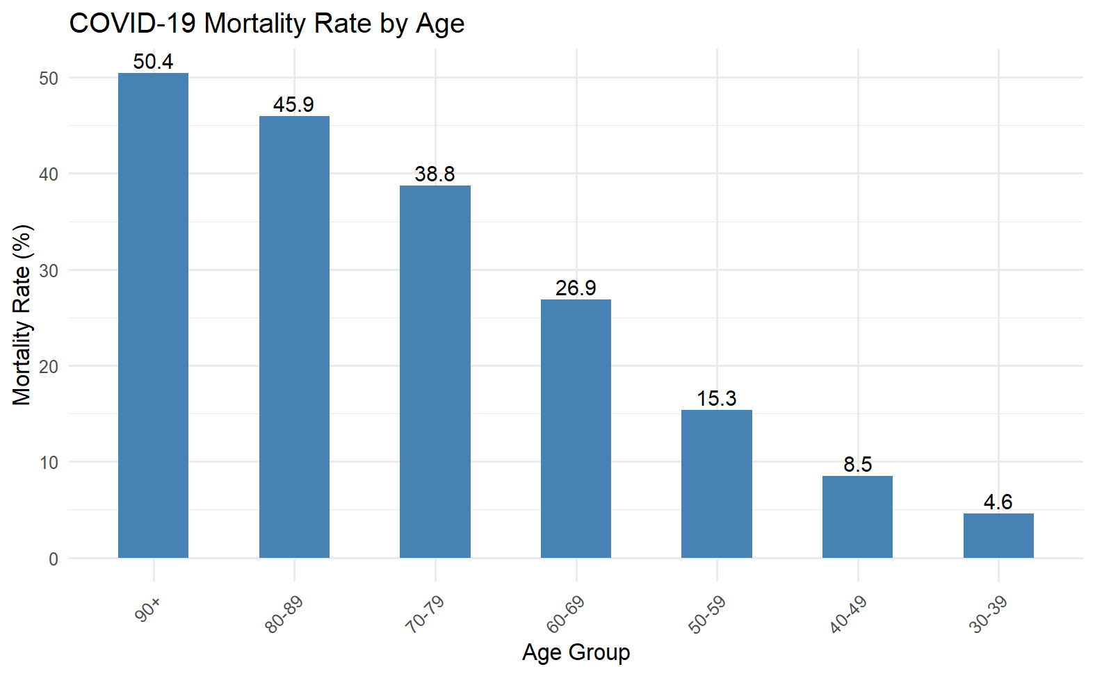
Mortality rate by Sex, and Age
Mortality in Males higher by 6 .4%
> 38% mortality among patients 70years and above
50% mortality in patients aged 90+

Slide 9
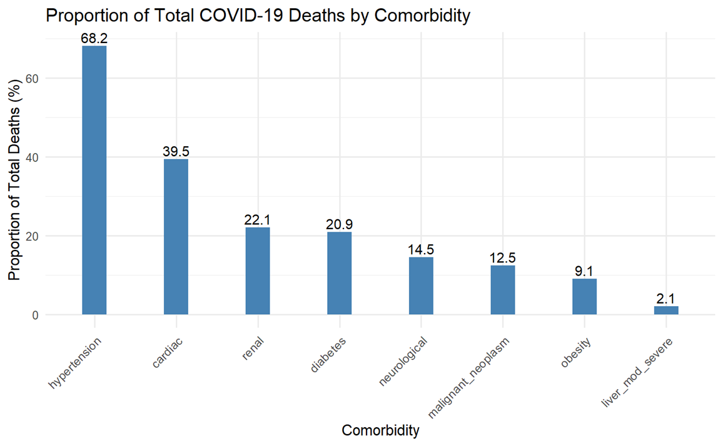
Comorbidities and patients’ death due to COVID-19.
Hypertension (68%) and cardiac conditions (39.5%) were the most common comorbidities among COVID-19 deaths.
Comorbidities like renal disease (22.1%) and diabetes (20.9%) also significantly contributed to COVID-19 mortality.

Slide 10
Limitations
Missing Data: Hypertension (31%) and cardiac conditions (31%) had high missing data, managed via imputation. This may introduce bias, impacting the accuracy of risk factor identification and public health decision-making.
Limited Scope: The focus on hospitalized patients limits incidence calculation and may overestimate mortality, affecting the development of public health strategies for the broader population.

Slide 11
Conclusion
Key Findings:
Older age and comorbidities such as hypertension and cardiac disease significantly increase COVID-19 mortality risk.
Public Health Implications:
Prioritize healthcare resources and interventions for high-risk groups such as the elderly and those with comorbidities.
Risk Communication:
These findings can support targeted health messaging, advising elderly individuals and those with comorbidities to seek early testing and treatment.

Slide 12
Actionable Insights
Prioritize early detection and treatment for elderly patients and those with comorbidities.
Resource allocation should be directed to high-risk populations in future outbreaks.
Strengthen public health strategies through improved testing, treatment, and vaccination efforts for vulnerable groups.

